Slide 1

BMS COLLEGE OF ENGINEERING
(Autonomous Institute, Affiliated to VTU, Belagavi)
DEPARTMENT OF MACHINE LEARNING
(UG Program: B.E. in Artificial Intelligence and Machine Learning)
Course : Project Work on Machine learning
Course Code: 22AM5PWPML
CUSTOMER CHURN ANALYSIS & PREDICTION
Semester End Examination : Project Presentation
Date: March 13, 2023
Presented By,
Chaitanya Arya 1BM20AI020
Jassh H Porwal 1BM20AI026
Neer Alpeshkumar Patel 1BM20AI040
Vineet Uppal 1BM20AI059
Faculty In-Charge:Faculty In-Charge:
Prof. Arun Kumar N
Assistant Professor
Department of Machine Learning
BMS College of Engineering
Semester & Section: 5A
Batch Number:

Slide 2
Agenda
Introduction
Literature Review
Open Issues
Problem Statement
Proposed Methodology
Functional & Non-Functional Requirements
Expected Outcome
Testing and Validation
Conclusion
References

Slide 3
•Introduction
Predicting customer churn is a crucial task for any business. It helps the company identify customers who are likely to stop using their services and take necessary action to retain them.
In this Customer Churn prediction we are analysing the past behaviour of customers then predicting whether churn will happen in future by customers or not. By taking into account details like Monthly charges , services they have subscribed for , tenures , contract they will contribute into prediction.

Slide 4
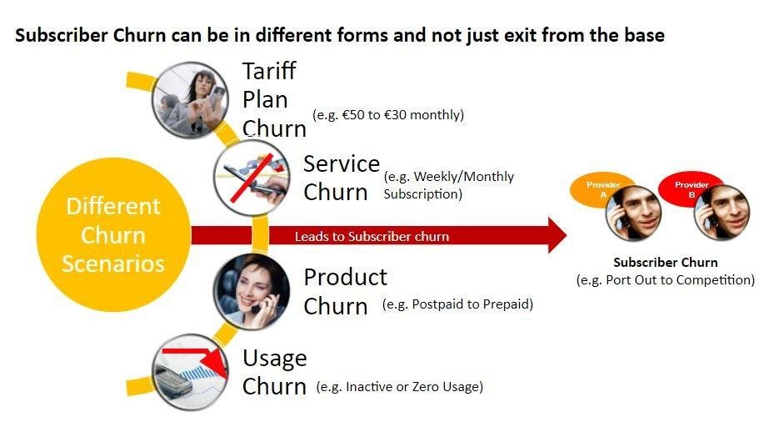

Slide 5
•Literature review
TITLE OF THE PAPER | YEAR | TECHNIQUES | RESULTS | LIMITATIONS
Bayesian network classifiers for identifying the slope of the customer lifecycle of long life customers | 2021 | Bayesian network classifiers and artificial intelligence techniques | classifying customers in the binary classification | the creation of variables have not considered the predictive capabilities
Separating Financial from Commercial Customer Churn | 2020 | Random Forest | Reduce the inherent conflict between those two departments | Cost effectiveness has not been considered
Customer churn prediction using improved balanced random forests | 2020 | artificial neural networks, decision trees, and class- weighted | Determine the distribution of samples and improving the effectiveness and generalization ability. | time series and trend analysis has not been considered
Variable selection by association rules for customer churn prediction of multimedia on demand | 2020 | Association Rules and Neural Networks | Enhance the probability of retaining customers. | time series and trend analysis has not been considered

Slide 6
.
TITLE OF THE PAPER | YEAR | TECHNIQUES | RESULTS | LIMITATIONS
Applying Data Mining to Customer Churn Prediction in an Internet Service Provider | 2022 | Data Mining Techniques | identify the best churn predictors | Evolutionary optimization techniques has not been considered
Customer churn prediction in telecom using machine learning in big data platform | 2020 | GBM algorithm,Random forest,Decision Tree | In marketing decide to predict the churn before 2 months of the actual churn action, in order to have sufficient time for proactive action with these customers. | The decrease in result could be due to the non-stationary data model phenomenon, so the model needs training each period of time
Review of Customer Churn Analysis Studies in Telecommunications Industry | 2020 | Logistic Regression (LR) , Voted Perceptron (VP) Support vector machines (SVM) Recursive PARTitioning (RPART) | To determine customers own close network, regarding the behavioral influence on customers to the extent of termination of service. | New hybrid models that are based on communications of individuals with users in their social networks are not been effectively used.
Churn Prediction on Huge Telecom Data Using Hybrid Firefly Particle Swarm Optimization Algorithm Based Classification | 2021 | Firefly algorithm based classification,PSO Algorithm based classification,Hybrid Firefly algorithm | HFFPSO algorithm provides better ROC compare than PSO and FF algorithms. The proposed HFFPSO shows better ROC value than the existing methods which indicates more accurate prediction result in churn dataset. | PSO is not ensured optimal position in large churn dataset and hence it leads inaccuracy prediction results. FFA has problem with light intensity thus it provides lower optimal results.
.

Slide 7
•Open Issues
Class Imbalance
The first and foremost challenge is the class imbalance problem, which can be addressed through bagging algorithms or oversampling
Data Accuracy
The churn prediction are largely dependent on customer usage patterns. This requires data to be taken from various sources (RDS, AWS, MongoDB, etc) and aggregated monthly.
This means that a breakdown within any data pipelines, at any time, can potentially cause incorrect features and lead to a poor prediction model.

Slide 8
Problem Statement
Telecom companies face a significant challenge in predicting and preventing customer churn. Losing customers can have a negative impact on revenue, and acquiring new customers can be costly. Therefore, it is important for telecom companies to identify at-risk customers and take appropriate action to retain them.
The goal of this machine learning project is to build a model that can accurately predict customer churn in the telecom industry based on historical data. The model will be trained on data such as customer demographics, account information, and interactions with the company (e.g. call data, data usage).

Slide 9
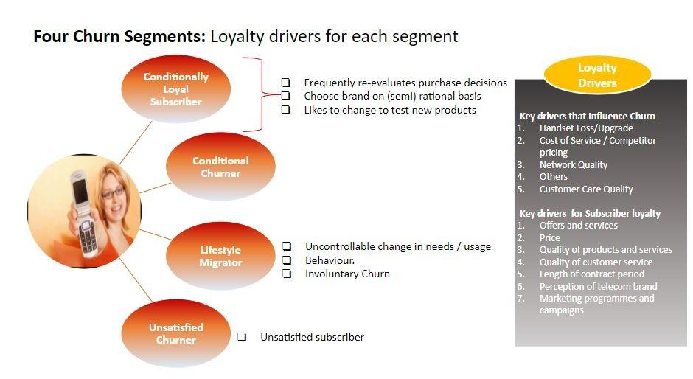

Slide 10
Functional Requirements
Churn prediction: The system should be able to analyze the data and predict which customers are likely to churn, based on patterns and trends in the data.
Churn prevention: The system should be able to recommend actions that can be taken to prevent churn, such as offering promotions or providing additional support to at-risk customers.

Slide 11
Non Functional Requirements
Scalability: The system should be able to handle large volumes of data and a high number of concurrent users.
Performance: The system should be able to perform churn analysis and prediction in a timely manner, with fast response times for users.
Security: The system should ensure the confidentiality and security of customer data, and comply with relevant regulations and laws.

Slide 12
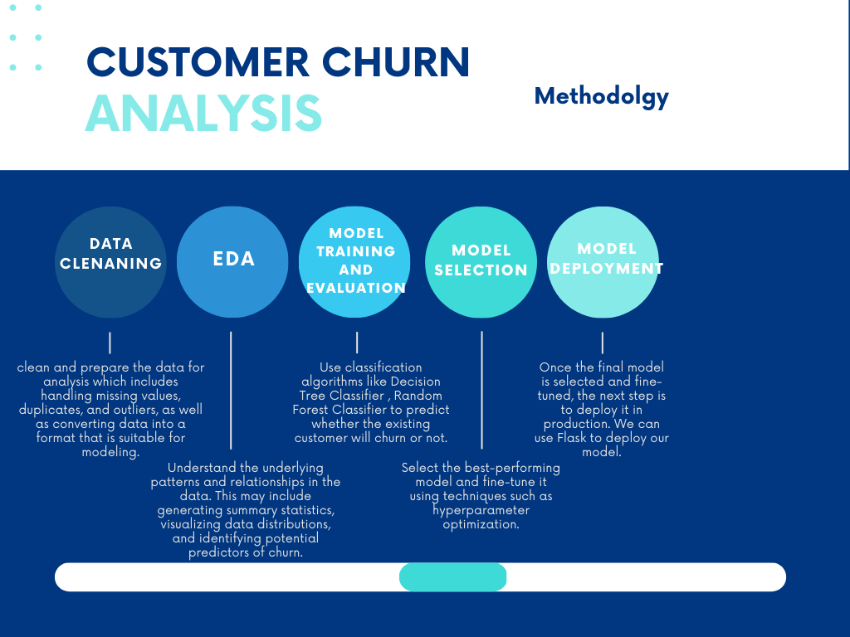

Slide 13
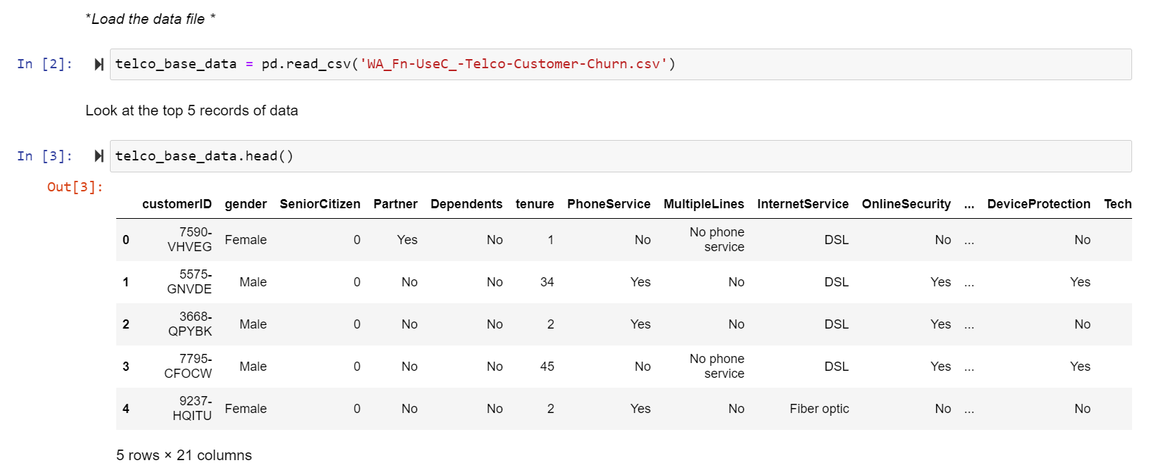
Implementation
Importing dataset

Slide 14
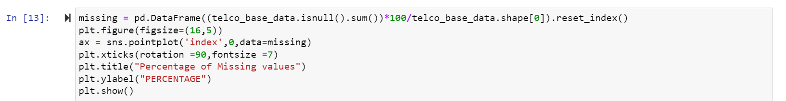
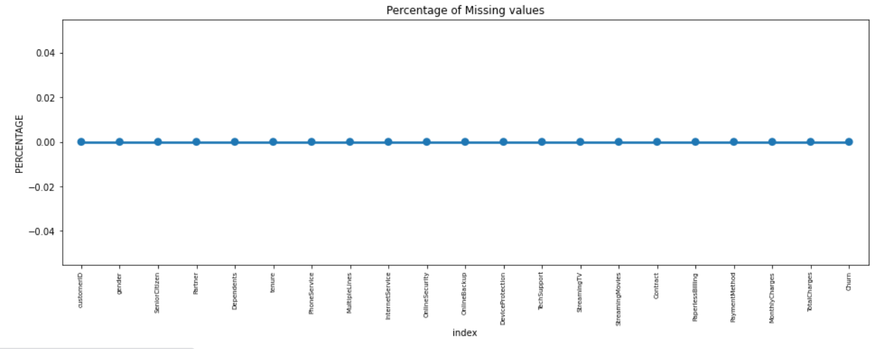
Data Cleaning

Slide 15
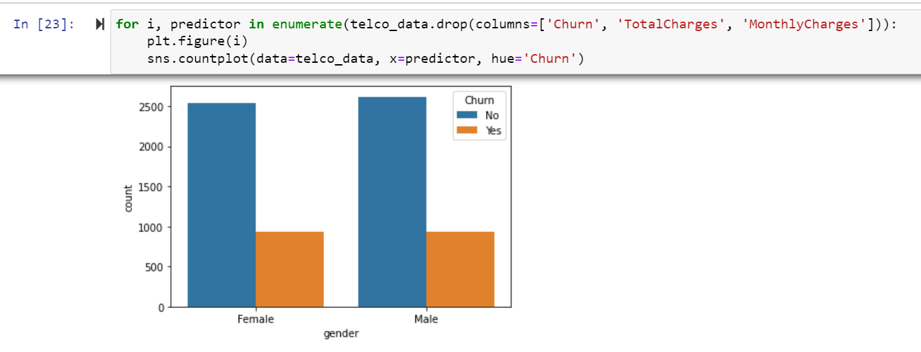
EDA
Univariate Analysis

Slide 16
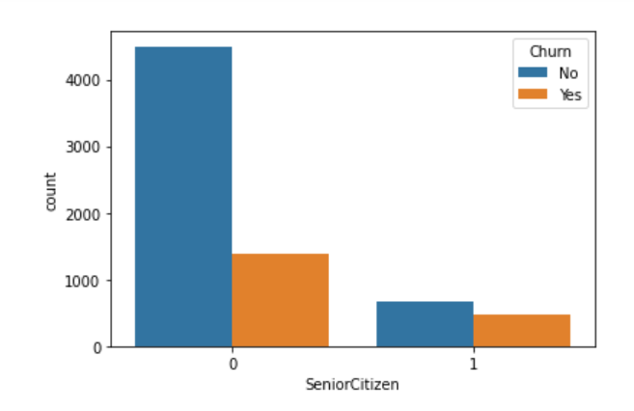
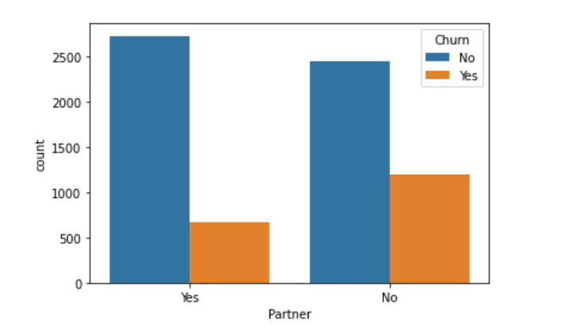
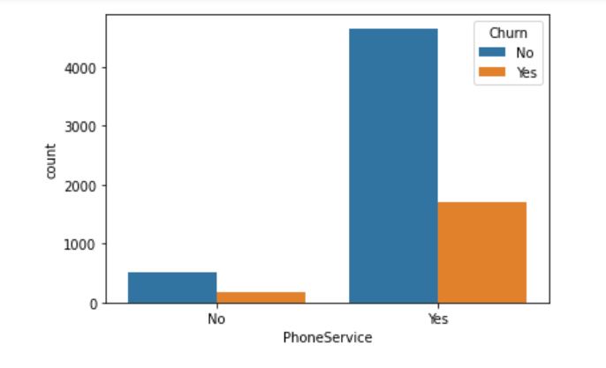
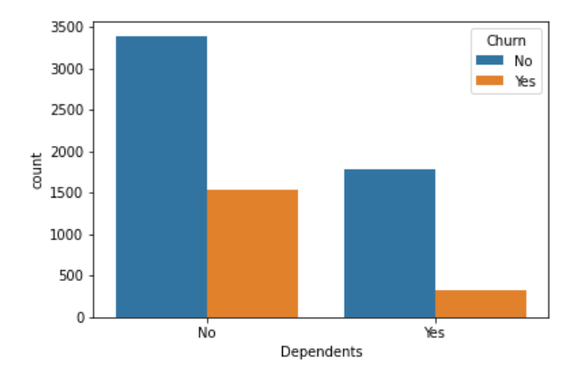

Slide 17
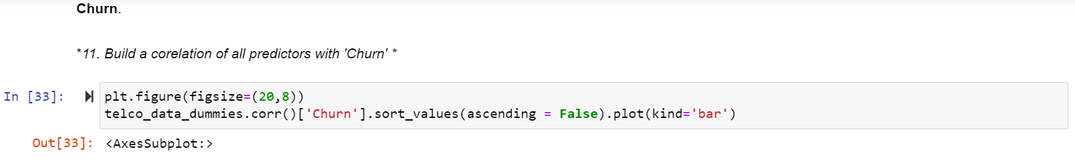
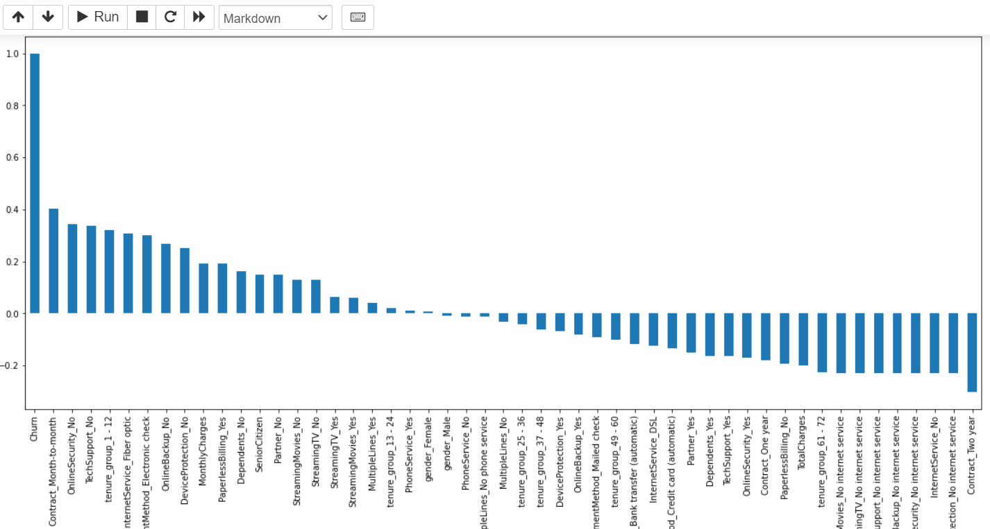

Slide 18
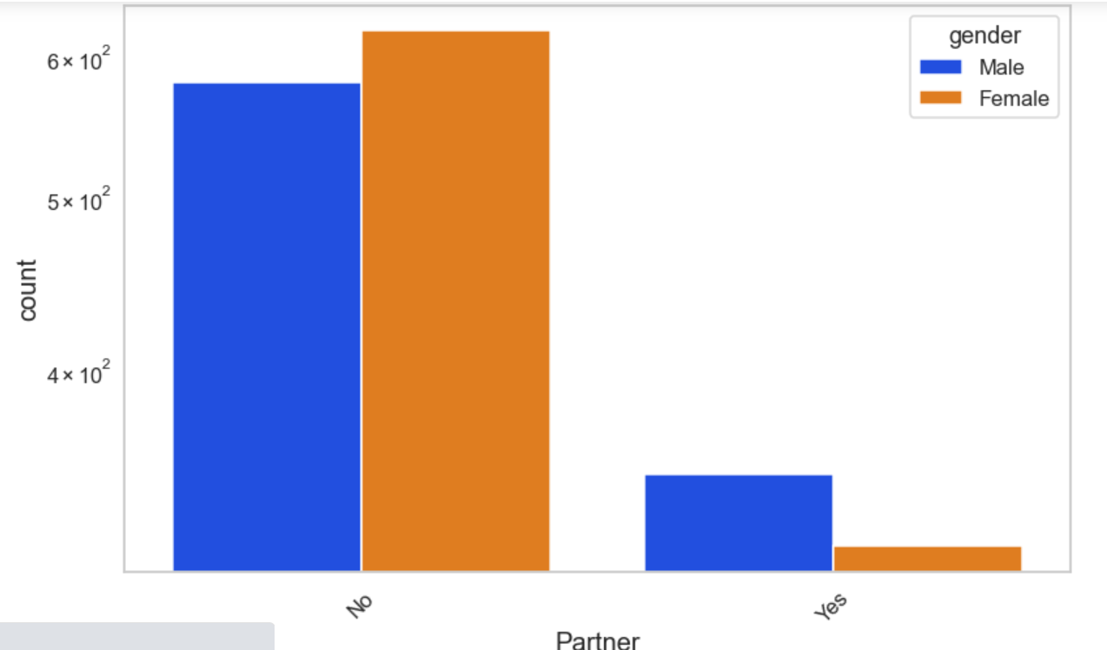
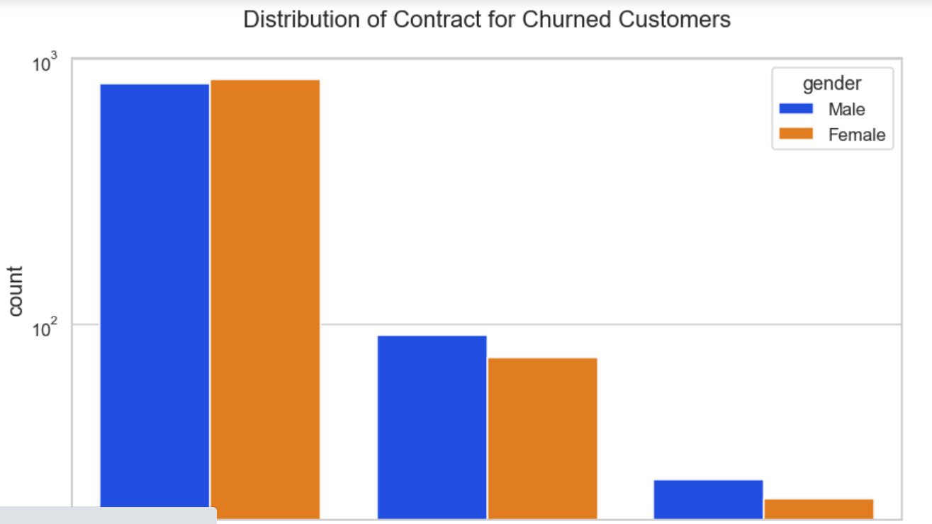

Bivariate Analysis

Slide 19
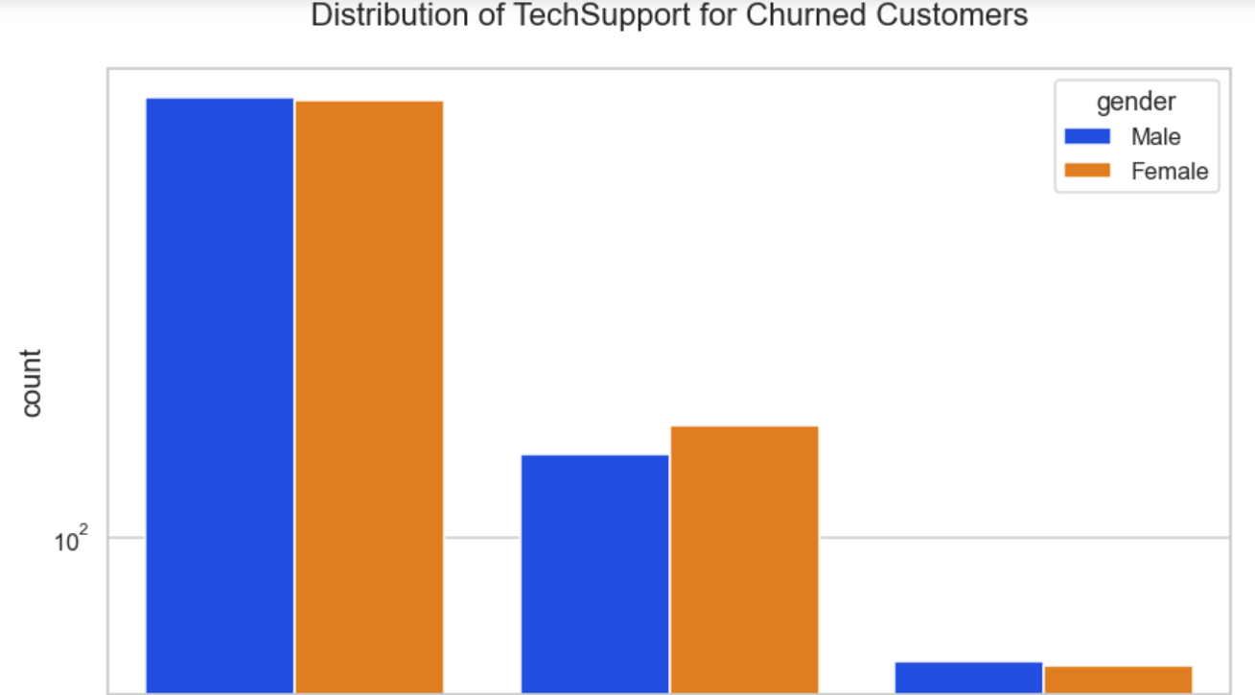
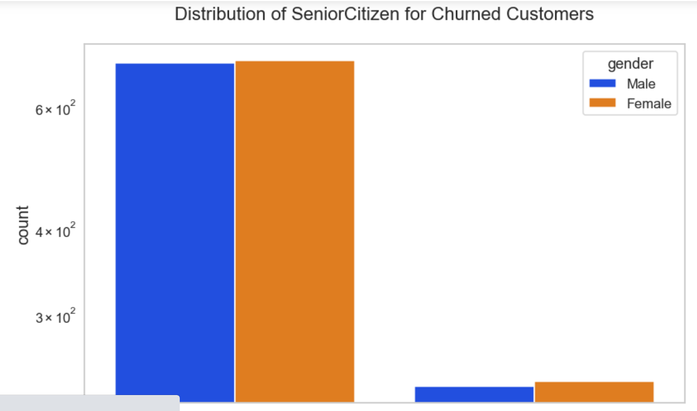
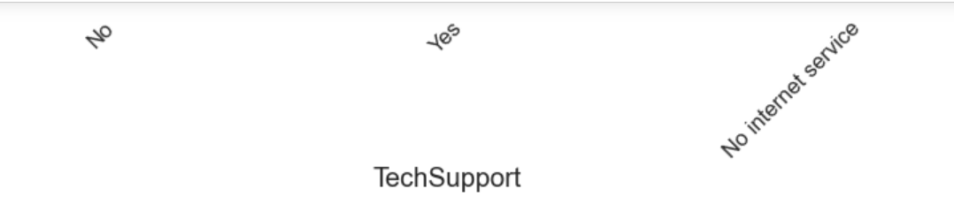
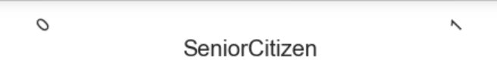

Slide 20
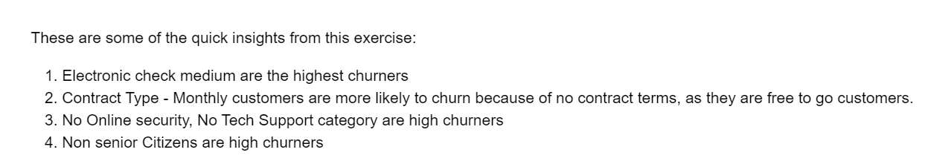
Conclusion from EDA

Slide 21
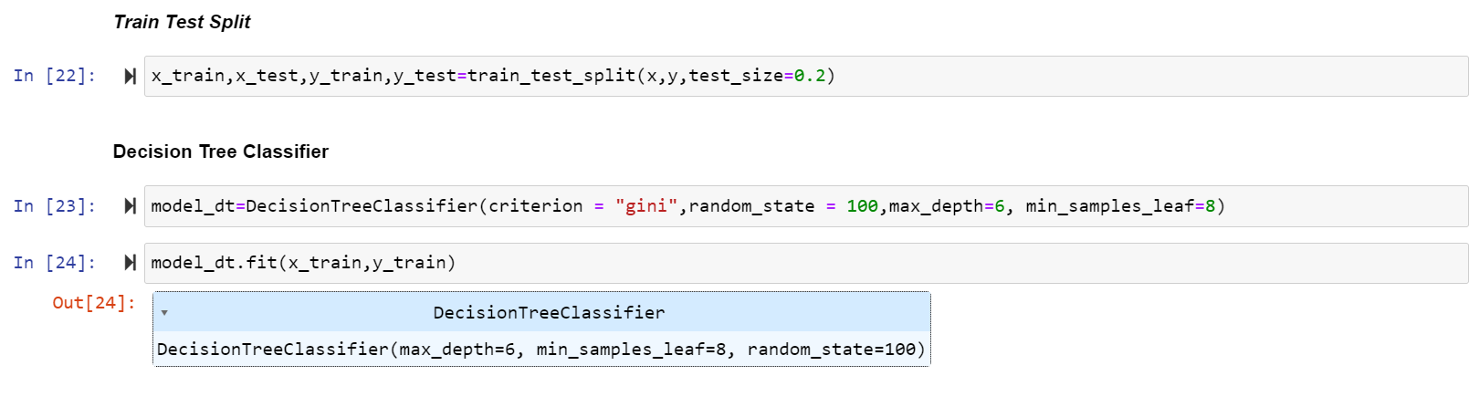
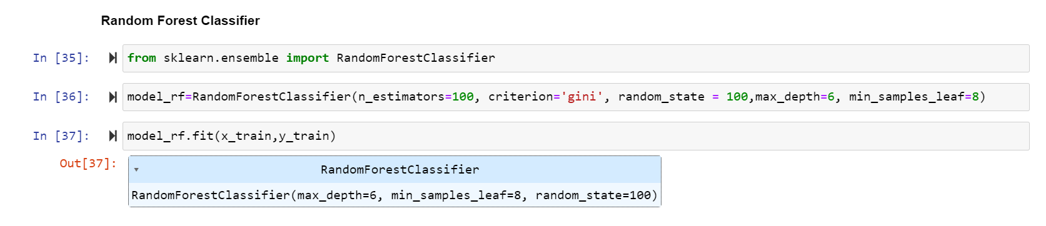
Model Training

Slide 22
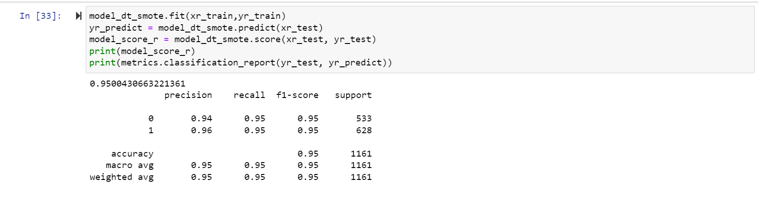
Testing and Validation
1)Decision Tree Classifier

Slide 23
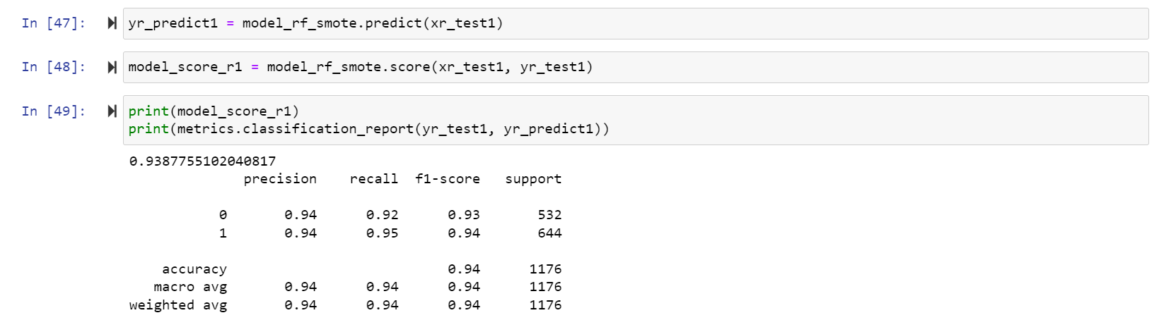
Testing and Validation
2)Random Forest Classifier

Slide 24
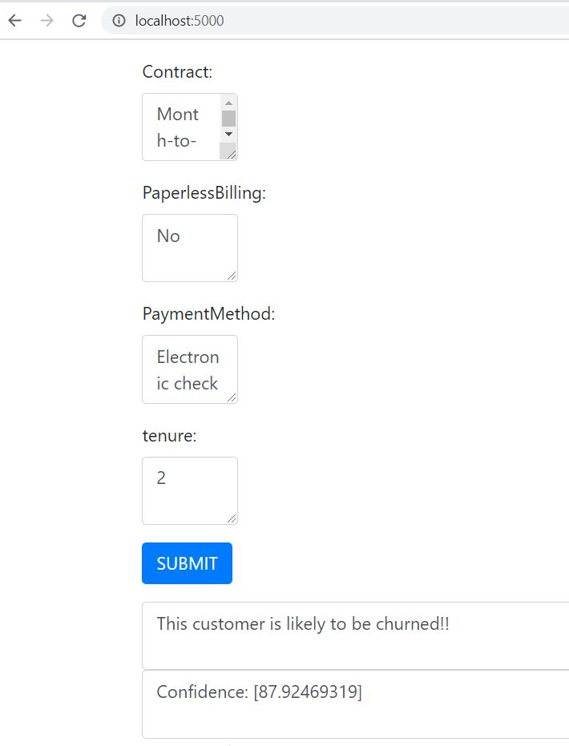
Results
Model Deployed
using Flask

Slide 25
Conclusion
The results of the model are used to develop a customer retention strategy that helps the telecom company reduce churn rates and improve customer loyalty. The success of the model will be evaluated on its ability to accurately predict churn, and its potential impact on the company's bottom line.
Overall, a customer churn analysis can help a telecom company to better understand its customers, identify churn risks, and develop strategies to improve retention rates.

Slide 26
References:
[1]Bart Baesens a, Geert Verstraeten b, Dirk Van den Poel,Bayesian network classifiers for identifying the slope of the customer lifecycle of long-life customers, pp. 39259–39835, 2021.
[2] Jonathan Burez, Dirk Van den Poel,Separating Financial from Commercial Customer Churn,pp. 39839–39851, 2020.
[3] Yaya Xie a, Xiu Li a, E.W.T. Ngai b, Weiyun Ying c,customer churn prediction using improved balanced random forests,pp. 105–111, 2020.

Slide 27
[4]Chih-Fong Tsai *, Mao-Yuan Chen,Variable selection by association rules for customer churn prediction of multimedia on demand, pp. 271–275, 2020.
[5] Afaq Alam Khan,Sanjay Jamwal,M.M.Sepehri,Applying Data Mining to Customer Churn Prediction in an Internet Service Provider,pp. 508-523, 2022.
[6]Abdelrahim Kasem Ahmad, Assef Jafar and Kadan Aljoumaa,Customer churn prediction in telecom using machine learning in big data platform,pp.28,2020.
[8]

Slide 28
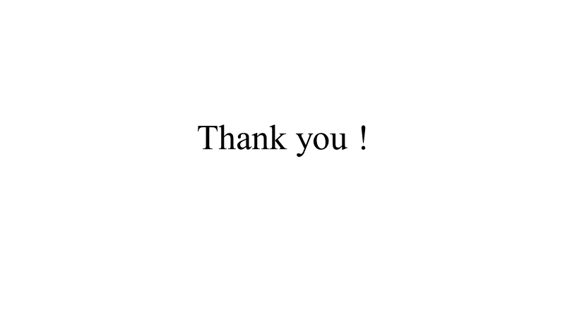

Slide 29
